Slide 1

Diagnostic Errors and measures to minimize it
Dr Divendu Bhushan
Associate Professor and Head
Department of Emergency Medicine
All India Institute of Medical Sciences Patna

Slide 2

Definition
A diagnostic error emerges when a
diagnosis is missed,
inappropriately delayed,
or is wrong.
There may be overlaps in these classifications.

Slide 3
Diagnostic errors are a failure to provide an accurate and timely explanation of the patient’s health problems or communicate that explanation to the patient.
They are considered as missed opportunities to make a correct or timely diagnosis based on available evidence.

Slide 4
Burden of Diagnostic errors:
Lack of culture of reporting and recording medical errors precise data are not available.
A study conducted in a high-income country found that approximately 5% of adults experienced diagnostic errors in outpatient settings each year. Over half of these errors had the potential for severe harm.
The researchers suggested that this was likely to be an underestimate and the rate of diagnostic errors in low-income countries may be much higher.

Slide 5
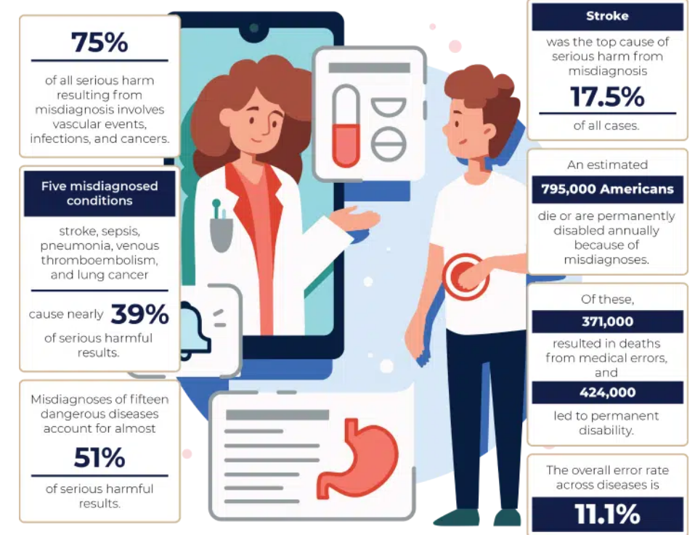
As per a study, it is estimated that around 5.2 million injuries occur due to medical errors, resulting in around 3 million preventable deaths every year. For every 100 hospitalizations, an average of 12.7 adverse events occur.
Delays in diagnosing cancer are common. Lack of continuum of care and communication to patient of abnormal test results lead to delay in diagnostic errors.

Slide 6
Levels of Diagnostic Error in Patient care
2. Diagnostic test
3. Follow Up
1. Initial Assessment
Diagnostic Errors
4.Refferal Related Communication
6. Adherence of the patient.
5.Behaviour
of the patient

Slide 7
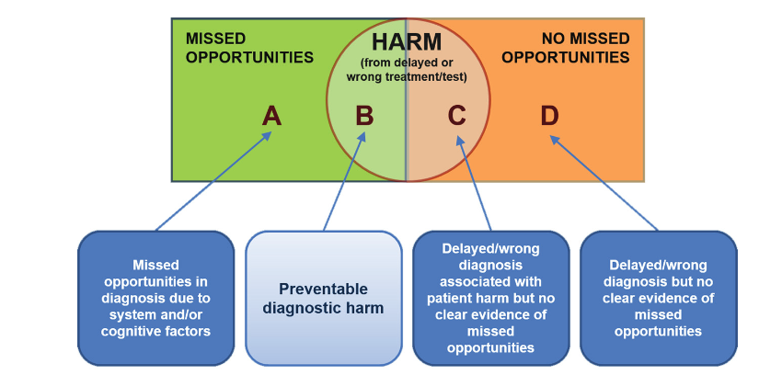
Conceptual model for missed opportunities in diagnosis

Slide 8
Examples
Background: A 45-year-old woman visits her primary care physician with complaints of persistent fatigue and occasional abdominal pain. The physician attributes her symptoms to stress and prescribes anti-anxiety medication. Outcome: Six months later, the patient is diagnosed with advanced ovarian cancer. Earlier detection through appropriate imaging or referral to a specialist could have improved her prognosis. Key Takeaway: Missed opportunities for early cancer diagnosis due to inadequate evaluation of vague symptoms.

Slide 9
Background: A 50-year-old man with chest pain and shortness of breath visits the emergency department. He has no history of heart disease but reports recent stress at work. The physician diagnoses anxiety and discharges him without conducting an ECG or cardiac enzyme tests. Outcome: The patient returns two days later with a massive heart attack, resulting in significant heart damage. Key Takeaway: Failure to perform appropriate diagnostic tests can lead to severe outcomes, particularly in time-sensitive conditions.

Slide 10
Background: A 30-year-old woman is diagnosed with migraine after recurrent headaches and visual disturbances. While her migraine is treated, her symptoms persist, and months later, she is diagnosed with a brain tumor. Key Takeaway: Over-reliance on a single diagnosis can lead to missed unrelated conditions.

Slide 11
Background: A 60-year-old woman presents to the hospital with sudden-onset speech difficulties and weakness in her right arm. The CT scan is misread as normal, and her symptoms are attributed to a transient ischemic attack (TIA). Outcome: The patient neurological deficit detoriated a day later, which could have been prevented with timely intervention. Key Takeaway: Errors in interpreting diagnostic tests can delay life-saving treatments.

Slide 12
Background:
A 28 yr old male with multiple episodes of jaundice on/off presents with dengue fever. Patient LFT was abnormal and on further work up diagnosed to have liver cirrhosis.
Key Takeaway:
patient had multiple episodes of on/off jaundice(missed oppurtunities) which were ignored thinking benign diseases and later developed into full blown cirrhosis.

Slide 13
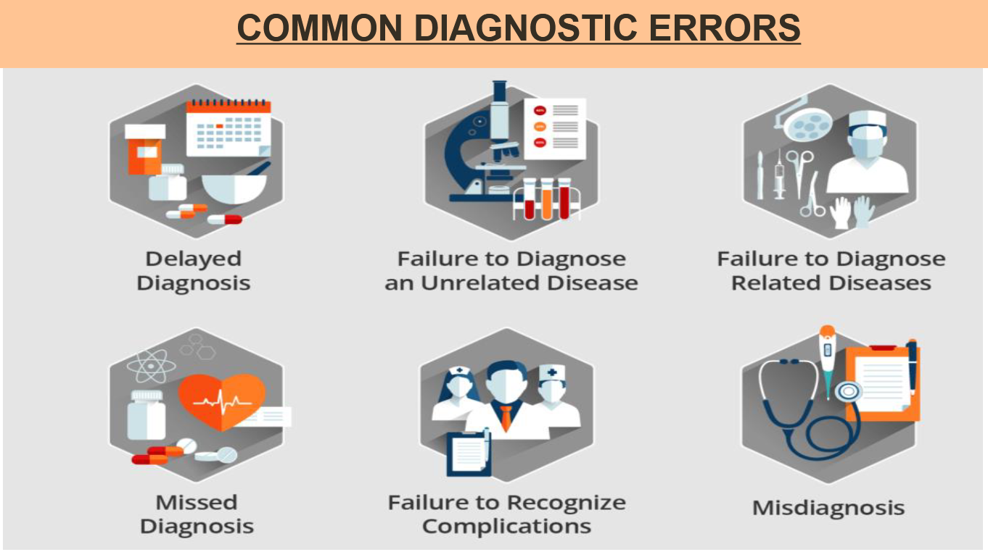

Slide 14
Delayed diagnosis: When a doctor eventually makes the correct diagnosis, but it takes a significant period of time.
Failure to diagnose an unrelated disease: When a medical professional accurately diagnoses a specific disease but fails to diagnose another unrelated disease that was also present.
Failure to diagnose related diseases: When a doctor correctly diagnoses one disease but doesn’t diagnose another related disease.
Misdiagnosis: A misdiagnosis occurs when a doctor diagnoses a patient with the wrong illness.
Failure to recognize complication: when doctors make the correct diagnosis for a patient but fail to identify certain complications or other factors that may change or aggravate the condition.
Missed diagnosis- when a
doctor gives a patient a clean
bill of health in cases where
that patient is actually
suffering from a disease or
illness.

Slide 15
FACTORS CONTRIBUTING TO DIAGNOSTIC ERRORS:
Cognitive
error
Failure to synthesize the available evidence correctly
System
flaws
Problems with communication or coordination of care
Lack of communication
Patient-doctor relationship.
Doctor-healthcare providing team.
failure to use physical examination or test data appropriately
Problem with availability of correct medical record, insufficient access to specialists.

Slide 16
S.NO | Factors | Possible issues contributing to error
1. | Access to high quality treatment | Limited access due to lack of money, remoteness, illiteracy, travel constraints or a limited number of health care facilities.
2. | Team-work | Poor teamwork, lack of learning and feedback when errors occur.
3. | Availability of diagnostic tests | Diagnostic tests limited in scope, availability or quality.
4. | Care Coordination | Consultations delayed or test results lost or a lack of health records documenting care.
5. | Follow-up | Limited follow-up reduces the ability for diagnostic impressions to evolve.
6. | Affordability of care | Care unaffordable or compromises other basic needs such as food or housing.
7. | Human factors and Cognitive issues | The work environment and systems may be subject to distractions, interruptions and a lack of organization of information

Slide 17
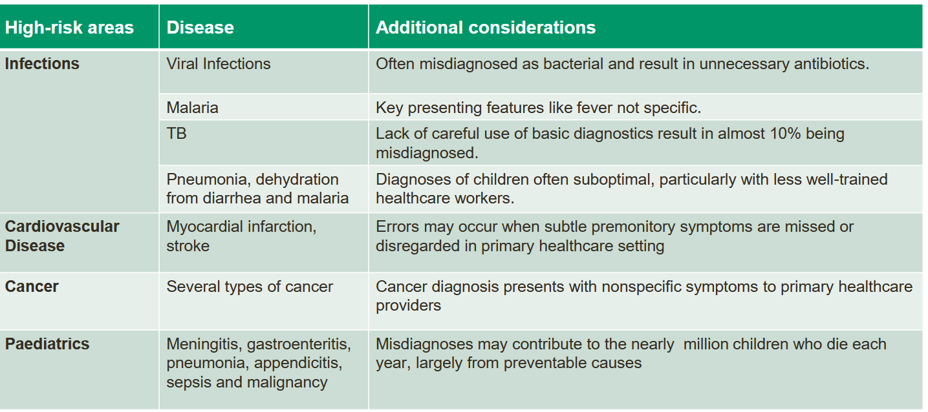
Condition involved in Diagnostic Errors:

Slide 18
Common conditions which we miss often
Infections
Pulmonary diseases
Stroke
Cancers
Paediatric diseases
Atypical presentations of common diseases are common than typical symptoms of uncommon diseases

Slide 19
Potential intervention to reduce global
burden of diagnostic Errors

Slide 20
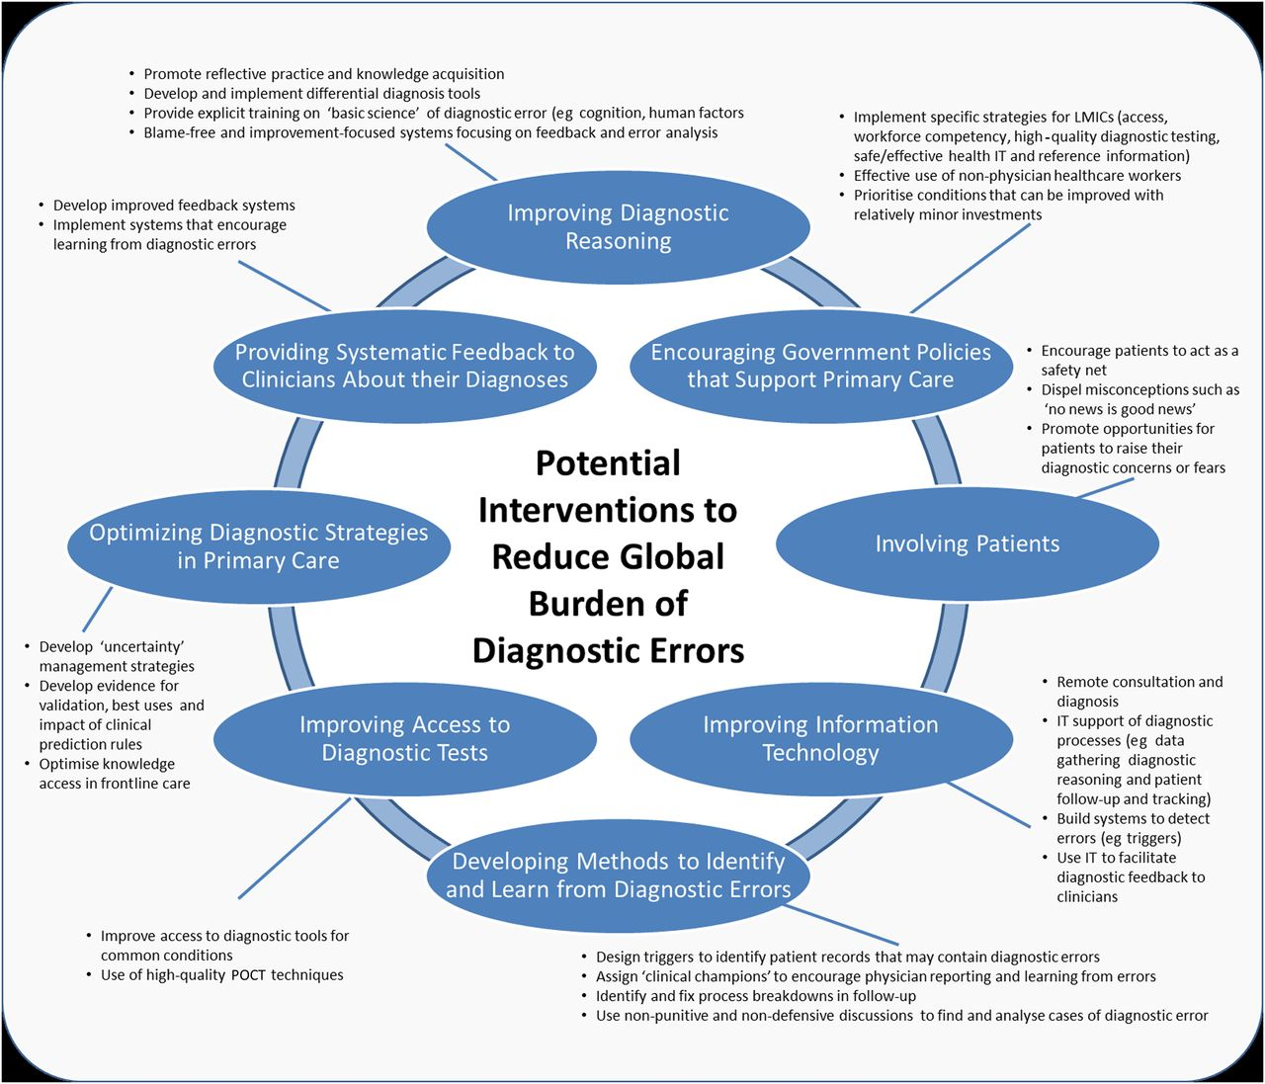

Slide 21
Improving Diagnostic Reasoning
Promoting reflective practises and knowledge acquisition
Develop and implement differential diagnosis tool.
Provide explicit training on “basic science” of diagnostic error( Eg: cognition, human factors)
Blame free and improvement focussed system focussing on feedback and error analysis.

Slide 22
Providing systemic feedbacks to clinicians about their diagnosis.
Implementations of systems that encourages learning from diagnostic error.
Development of feedback systems.

Slide 23
Optimizing diagnostic strategies in primary care
Develop “uncertainty” management strategies.
Develop evidence for validation, best use and impact of clinical prediction rules.
Optimise knowledge access in frontline care.

Slide 24
Improving access to diagnostic tests
Improve access to diagnostic tool for common conditions.
Use of high quality point of care techniques.

Slide 25
Developing methods to identify and learn from diagnostic errors:
Design tiggers to identify patient records that may contain diagnostic errors.
Identify and fix process breakdown in follow up.
Use non-punitive and non defensive discussion to find and analyse cases of diagnostic error.

Slide 26
Involving patients
Encourage patient to act as safety net.
Dispel misconcetion as” no news is good news”
Promote oppurtunities for pts to raise their diagnostic concern and fear.

Slide 27
Encouraging government policies that support primary care
.Implementing specific strategies for LMIC (access ,workforce competency, high quality testing safe/effective health IT and reference information)
.Effective use of non-physician healthcare workers
.Prioritise conditions that can be improved with relatively minor investment

Slide 28
Information technology in Preventing Diagnostic Errors
S.NO | PROCESS | HOW TECHNOLOGY CAN HELP
1. | Assists in information gathering | Helps ensure that prior records and data are available. Aids the collection of key clinical data, ensuring that relevant important questions are asked, improving completeness of parts of the history that are often neglected (e.g. smoking, family history and recent travel) and; using trigger tools to identify patients more likely to have a diagnostic error.
2. | Improves information organization and display | Decreases the cognitive burden and distraction and highlights key information to ensure they are not overlooked
3. | Improves access to reference information | Provides access to information, journals, images and clinical guidelines.
4. | Facilitates patient follow-up | Supports reliable, rather than ad hoc approaches to patient follow-up.Eg: remainder tools as wells as for healthcare provider.

Slide 29
5. | Provides tools for collaborative diagnosis | Facilitates access to second opinions from experts and makes it easier to solicit colleagues to discuss challenging cases, for example, via telemedicine or electronic consultations.
6. | Facilitates diagnostic feedback to clinicians | Establishes a clear chain of events while documenting the care process more accurately; any errors ultimately discovered can be fed back and shared as a learning experience by all.
7. | Helps detect diagnostic errors | Double checks can help catch mistakes; electronic algorithms can detect missed opportunities for diagnosis and discrepancies.
8. | Facilitates practice improvement research | Produce epidemiologic data and comparisons between providers, practices or geographic locations to allow the exploration of differences in patient outcomes and adverse events related to possible diagnostic error.

Slide 30
Conclusion
Diagnostic errors remain a significant challenge in patient safety, contributing to patient harm and avoidable deaths worldwide.
These errors often result from a complex interplay of human, systemic, and technological factors.
Addressing diagnostic errors requires a culture of safety, open communication, and continuous improvement in clinical practices.

Slide 31
Take Away
Understanding Root Causes: Focus on system-level improvements like better communication, structured handovers, and appropriate use of health IT.
Empowering Patients: Encourage patient engagement through education, shared decision-making, and access to health records.
Enhancing Clinical Skills: Regular training and simulation for healthcare professionals to recognize and mitigate diagnostic errors.
Leveraging Technology: Harness tools like AI and clinical decision support systems to augment diagnostic accuracy.
Commitment to Reporting and Learning: Foster an environment where errors are reported without fear and analyzed to prevent recurrence.

